Slide 1
GITHUB REPOSITORIES

Slide 2
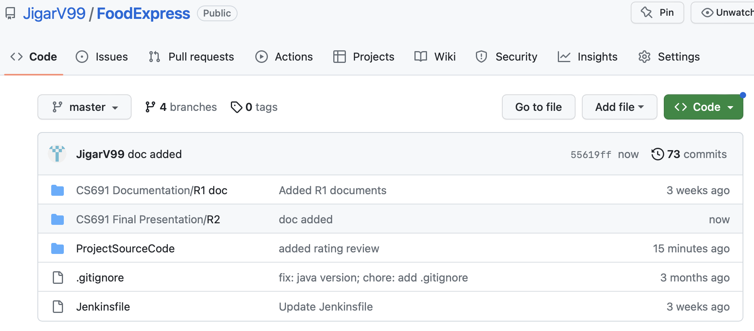
Github Link:
https://github.com/JigarV99/FoodExpress

Slide 3
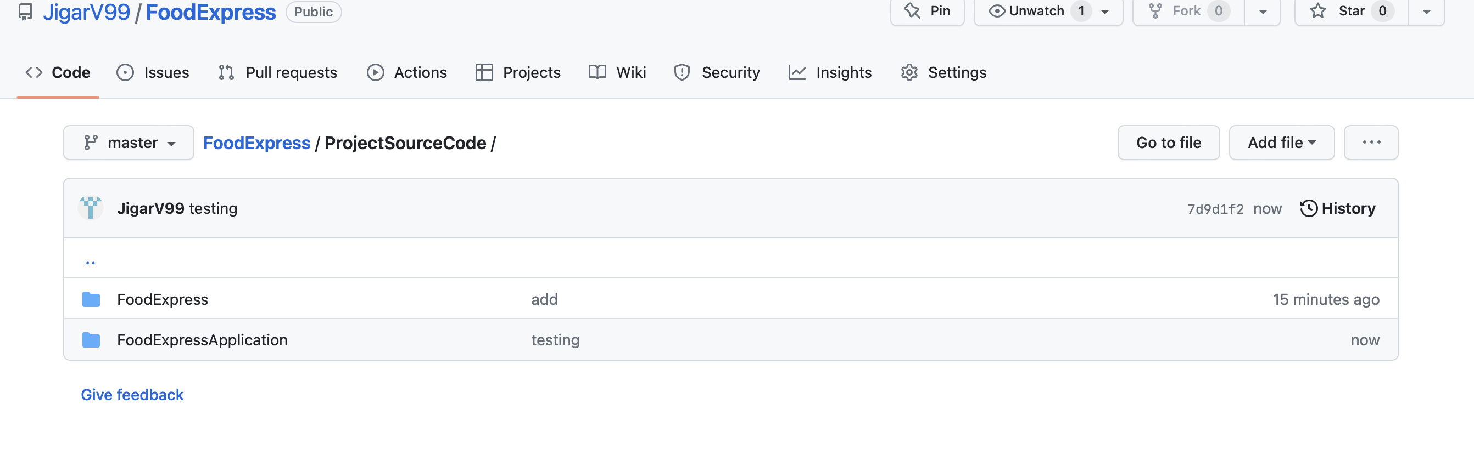
Front-end and Backend folder

Slide 4
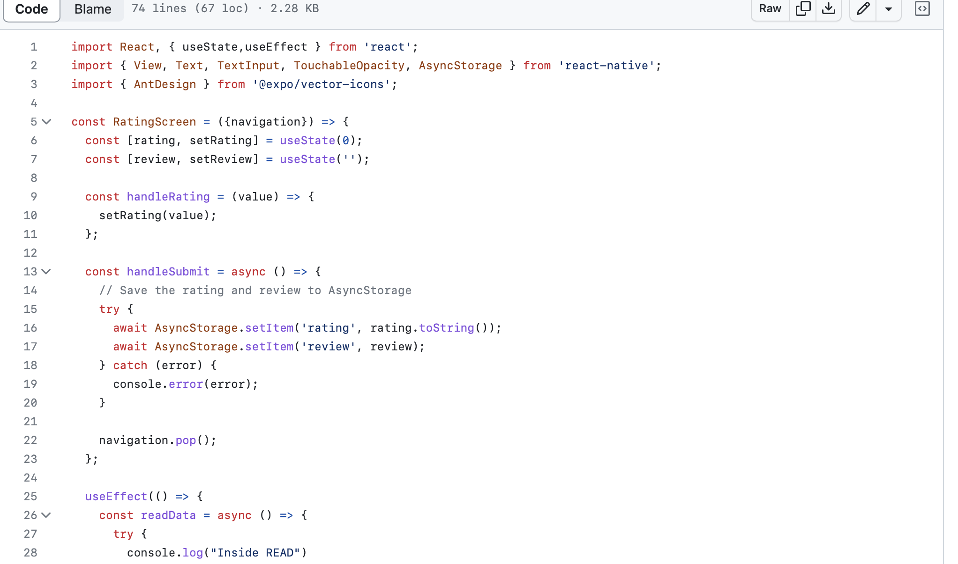
Front-end: Rating Screen

Slide 5
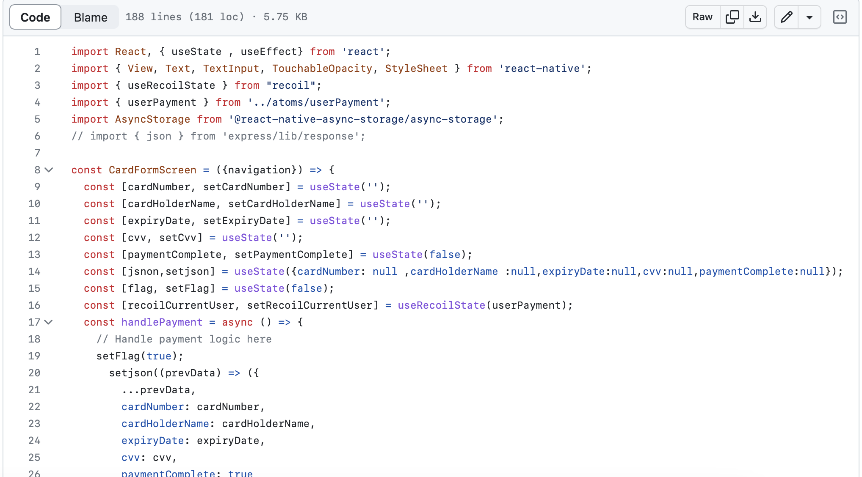
Front end: edit payment

Slide 6
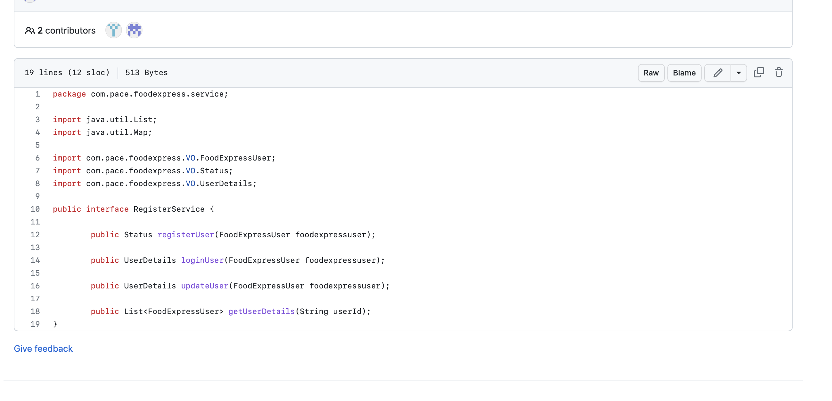
Backend Api

Slide 7
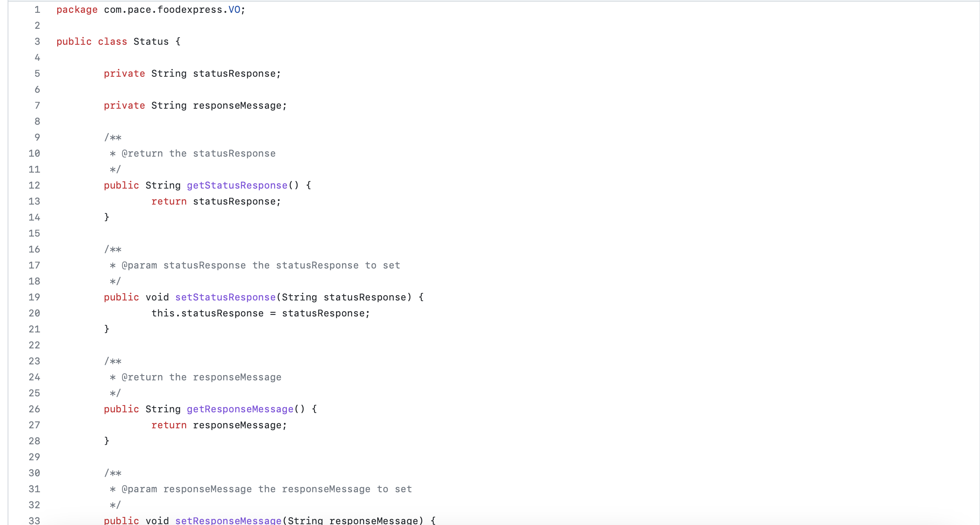
Backend

Slide 8
Deployment Procedure for application steps:
Launch an EC2 instance using the AWS console or the AWS command line interface (CLI). Choose an appropriate instance type and AMI (Amazon Machine Image) based on your requirements. Run the Instances In AWS.
In the Jenkins UI, go to Manage Jenkins > Configure System and scroll down to the AWS Global Configuration section.
AS we Jenkins on the EC2 instance,First login to Jenkins select development for testing that’s test everything is it working fine on development stage.
After selecting the stage in Jenkins. Click on Build now it will deploy the Application automatically.
After getting the success that mean its deployed successfully or else something is a problem is there we can take check on the console log error.
Overall, the deployment procedure for Jenkins in AWS involves launching an EC2 instance to run Jenkins, setting up AWS credentials in Jenkins, configuring a building job to build and deploy your application code, and testing the deployment process to ensure that it works as expected. By following these steps, you can quickly get up and running with Jenkins in AWS and begin automating your application deployment process.

